Slide 1
WNR
2/18/2016

Slide 2
Agenda
Relooking at BLE
Data Rate Re-analysis
Compression Requirements
Energy/Power Consumption
Compression
Analog Front-End and SPI
Requirement Variable Graphs

Slide 3
Summary of current status
Decided to pursue BLE
Discrete components working:
BLE @ max datarate
Intan conversion operational
Compression implemented @ 50%, compiled & loaded on board
Power measured @ very low consumption

Slide 4
BLE Data Rate Analysis
Require 128 kbps per probe
16 channels * 1000 samples/channel * 8 bit/sample
Nordic nrf52
Capable of sending 6 packets/connection interval; each packet is 20 bytes
Smallest connection interval is 7.5 ms
6 packets / connection * (1000 / 7.5) connection/sec * 20 bytes / packet
Total = 128 kbps
Still Require Some compression, even if just a little (x2)

Slide 5
BLE Data Rate Current State of Nordic NRF52
6 packets/interval
20 bytes/packet
6 packets / connection * (1000 / 7.5) connection/sec * 20 bytes / packet
~128 kbps

Slide 6
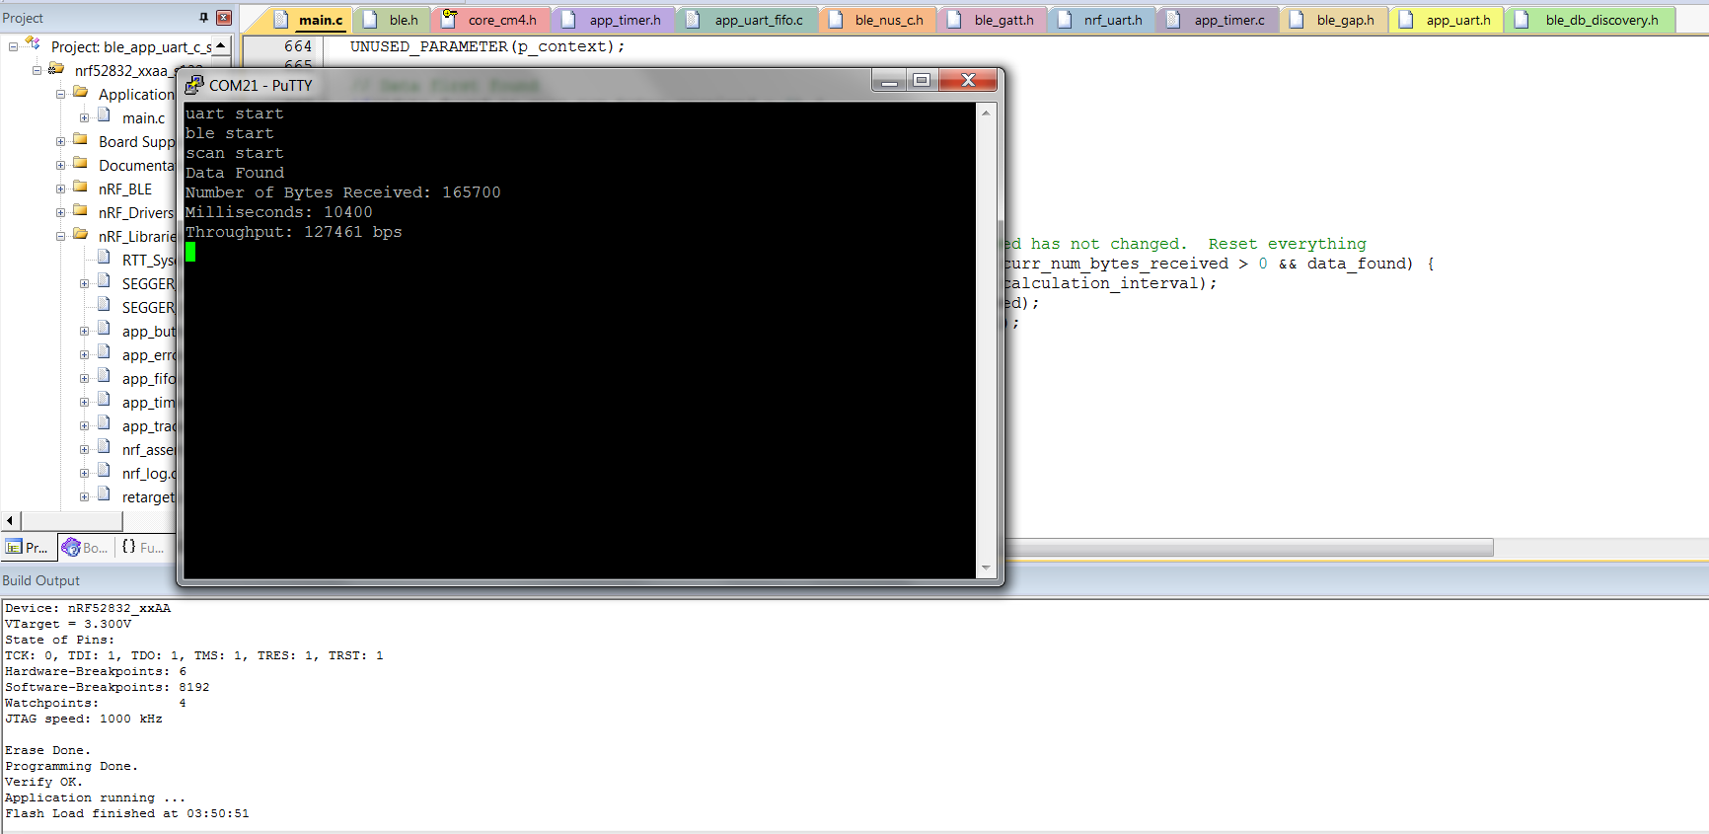

Slide 7
Compression Requirements
Assume 20% additional overhead
103 kbps is the expected raw data rate
Compression Ratio Required for throughput:
100% - (103kbps / 128kbps) = 19.53%
Compression Ratio Required for bandwidth:
1024Mbps / 2048Mbps = 50%

Slide 8
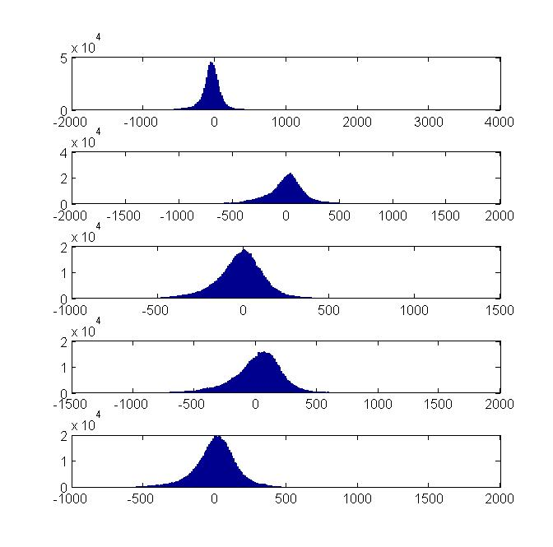
Compression Method
Convert double to uint8
Quantize
Convert 2’s complement to uint
Manually truncate parts of the data
Ran compression in cmd line on computer
Now compiling to run on NRF52 Board

Slide 9
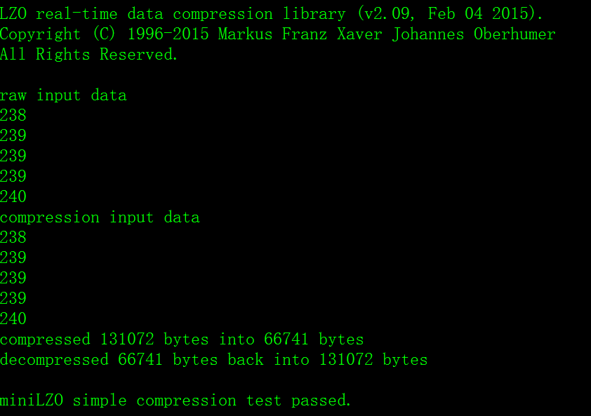
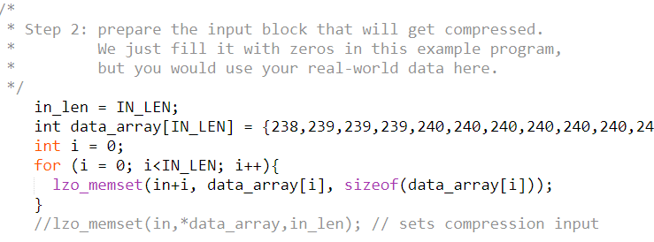
Compression results

Slide 10
Compression Mechanism
The compression process has three phases: storing, compressing, and sending. The data is required in a data structure in the following form:
typedef struct wnr_data {
uint8_t *data;
size_t size;
int channel_num;
} wnr_data;
which indicates the size and channel number of the data.

Slide 11
Compression Mechanism
The buffer manager contains 16 buffers for corresponding channels. When the buffer manager receives data, it automatically compress that chunk and call the sending handler to send the data. If the buffer is full during compression, it will flush the existing data and take the compressed data from the breaking point.
The data compression rate has been tested on actual data, and the optimized tradeoff point with efficiency and space is 8kB, where the compression ratio is 0.501. This is equivalent to the amount of data generated in 0.5 seconds on a single probe.

Slide 12
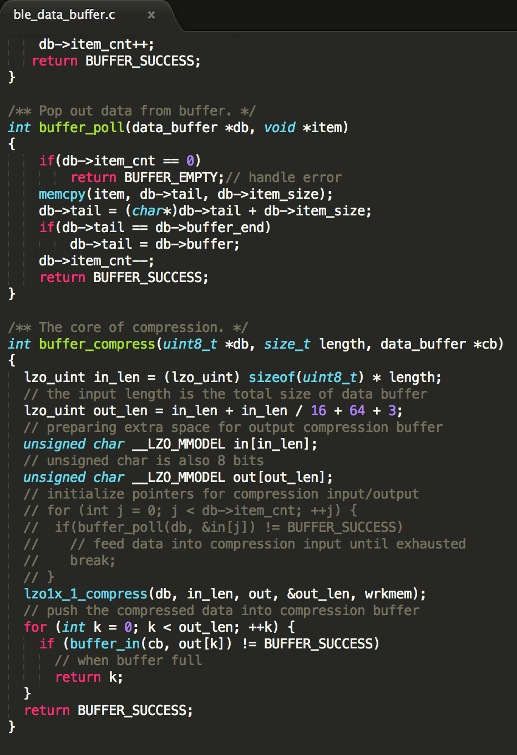
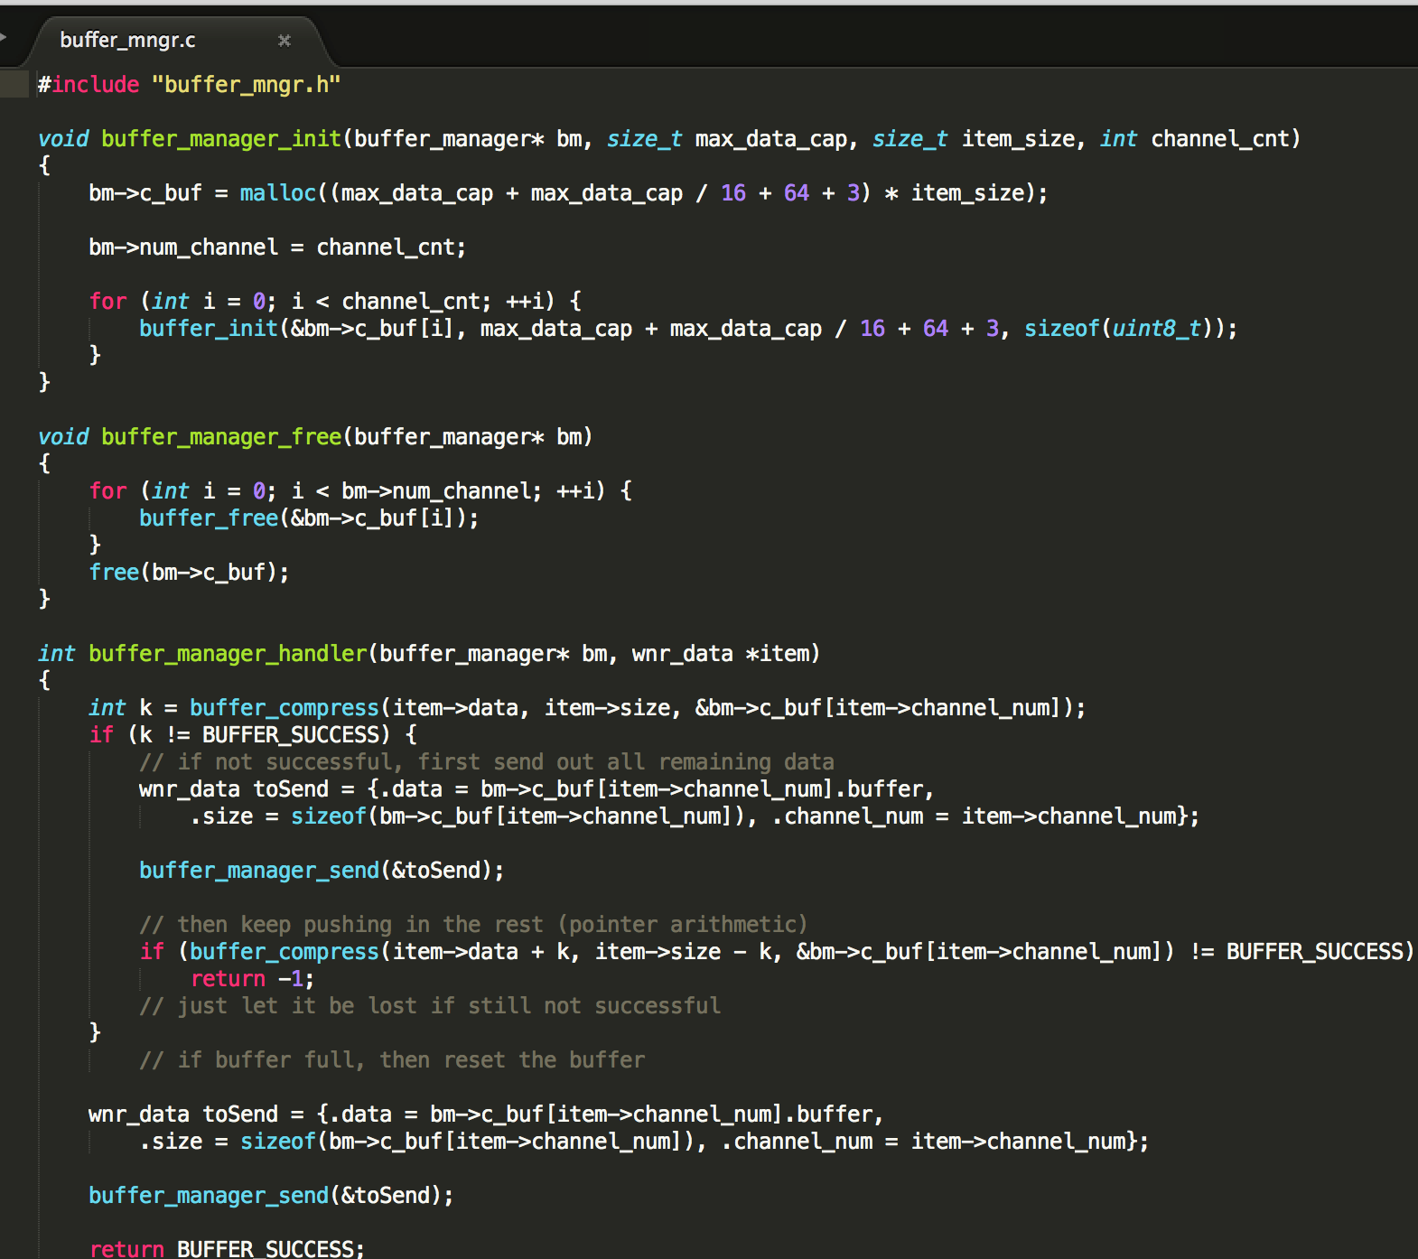

Slide 13
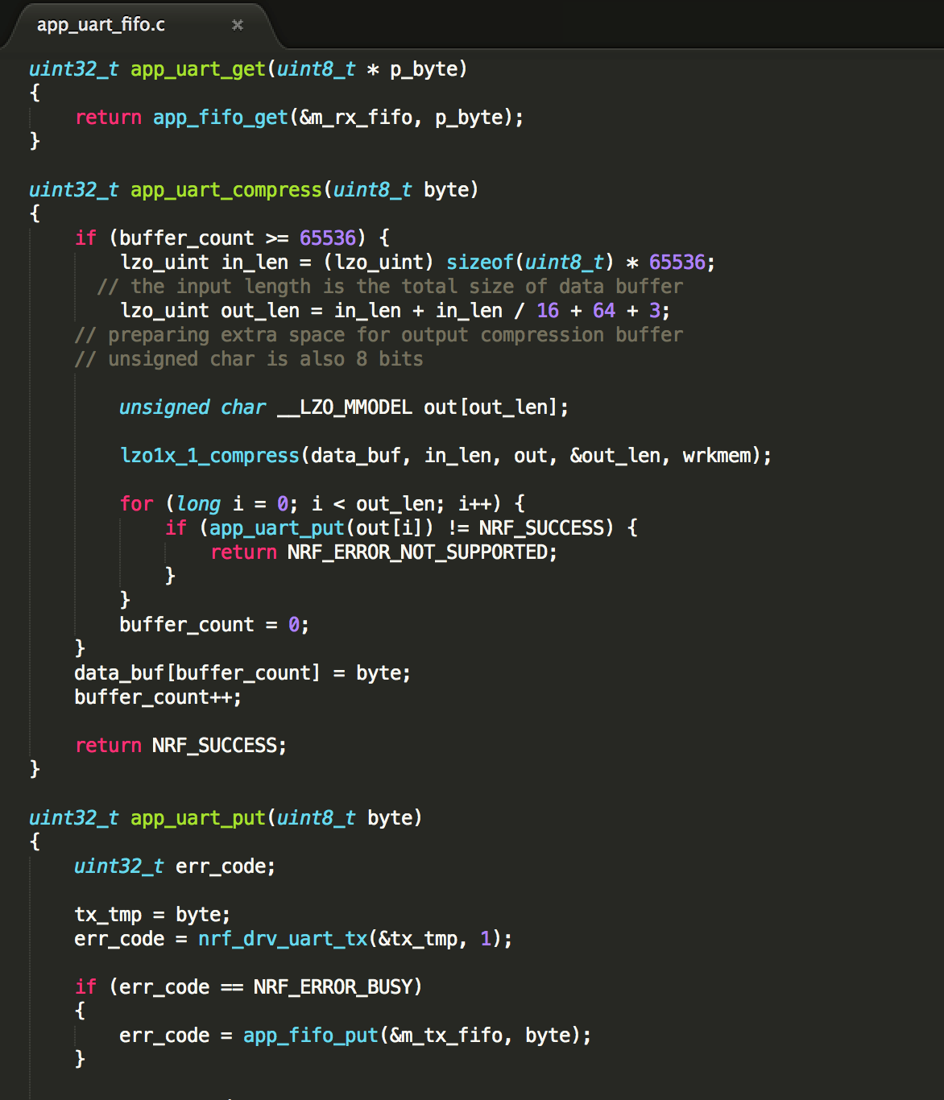

Slide 14
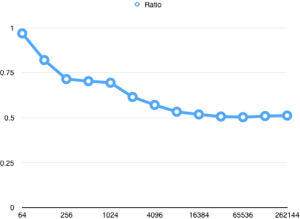
Compression Results (Real uint8_t Data Samples)
Size_after/Size before

Slide 15
1.28 mbps With Enhanced ShockBurst
Contemporary Nordic devices allow the firmware to use BLE and SB concurrently
The new payload length field, packet ID, and an acknowledge bit mean that payload lengths can be dynamic, packets can be acknowledged by the receiver, and unacknowledged packets can be automatically retried.
255-byte payloads in ESB modes.
Throughput is greatly improved when larger payloads are used
As an example, 1.28mbps throughput is possible when using five address bytes, two bytes of CRC, 2mbps baud rate, 252-byte payloads, and empty acknowledgement payloads.

Slide 16
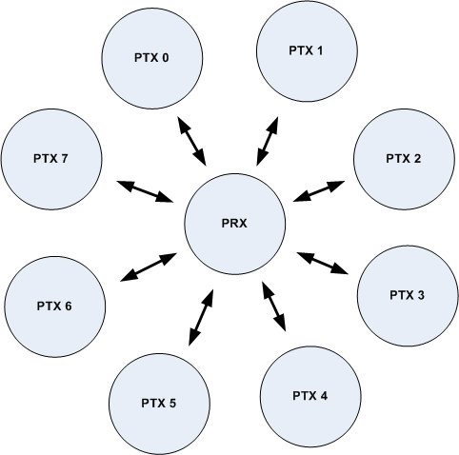
Enhanced Shock Burst
Nordic Protocol supporting two-way data packet communication including packet buffering
Supports a star network topology with typically one Primary Receiver (PRX) and up to 8 Primary Transmitters (PTX).
1 to 32 bytes dynamic payload length.
Bi-directional data transfer between each PTX and the PRX.
Packet acknowledgement and automatic packet retransmission functionality eliminates loss of data.
Notes:
https://devzone.nordicsemi.com/documentation/nrf51/4.3.0/html/group__esb__users__guide.html

Slide 17
Power Feasibility: AFE - Intan RHD2000
Amplifier:
Baseline = 200 uA
7.6 uA/kHz upper cutoff frequency/channel
ADC:
Baseline = 510 uA
2.14 uA/kHz/channel
Supply Voltage and Auxiliary Inputs:
40 uA

Slide 18
Power Feasibility: AFE - Intan RHD2000
Amplifier Current:
200 uA + 16 * 1* 7.6 uA/Khz/channel = 321.6 uA
ADC Current:
510 uA + 16 * 1 * 2.14 uA/kHz/channel = 544.24 uA
Supply Voltage and Auxiliary Inputs:
40 uA
Total Power Consumption with 3.3V Supply
3.3 * (321.6 + 544.24 + 40) = 2.99 mW
To run for 24 hours: (321.6 + 544.24 + 40) uA * 24 hours = 21.74 mAh

Slide 19
Power Feasibility: BLE Transmission - NRF52
Spec Sheet Transmit at +0 dBm:
5.5 mA
Power Consumption with 3.3 V power supply: 3.3V * 5.5 mA = 18.15 mW
To run for 24 hours: 5.5 mA * 24 hours = 132 mAh
Preview Board Testing
2.5 mA - 3mA while transmitting 48kbps on NRF52-Preview
Possibly transmitting at lower than 0dBm
Production Board Testing
No measured values yet for transmitting 128kbps on NRF52-Production
Current consumption TBD

Slide 20
Power Feasibility: Total System
AFE: 21.74 mAh
BLE at +0 dBm: 132 mAh
Total Power Consumption = 21.74 + 132 = 153.74 mAh
Using the Zinc-Air p13 battery (300 mAh) is enough to power both types of transmission with enough power for compression and other processing
Zinc Air P13 Battery
300mAh @ 1.45V
7.9mm x 5.4mm (d x h)

Slide 21
Total System Size
Zinc Air P13 Battery
7.9mm x 5.4mm (d x h)
Nordic NRF52
6 x 6 mm
Intan Chip
8 x 8 mm QFN
4.8 x 4.1 mm bare die
Total packaged size
~ 8mm^2 x 12mm

Slide 22
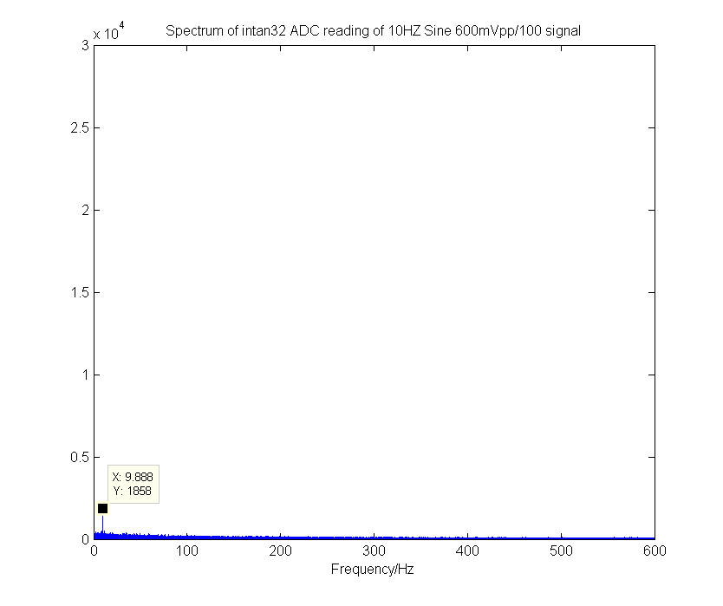
SPI & AFE
Verified that Intan Chip is functioning using nRF52 board
Tested with 10Hz sine signal

Slide 23
Questions

Slide 24
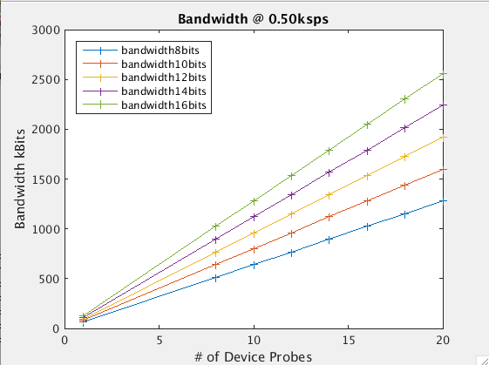

Slide 25
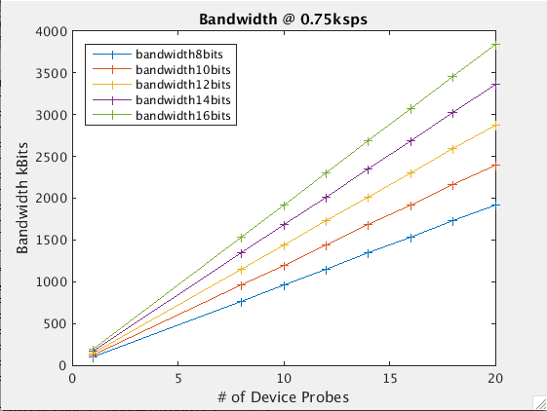

Slide 26


